Slide 1
Bonrix Embedded Innovations
Pioneering the Future of IoT and Embedded Systems
Embedded Innovation at its Finest
For best results, print to PDF

Slide 2
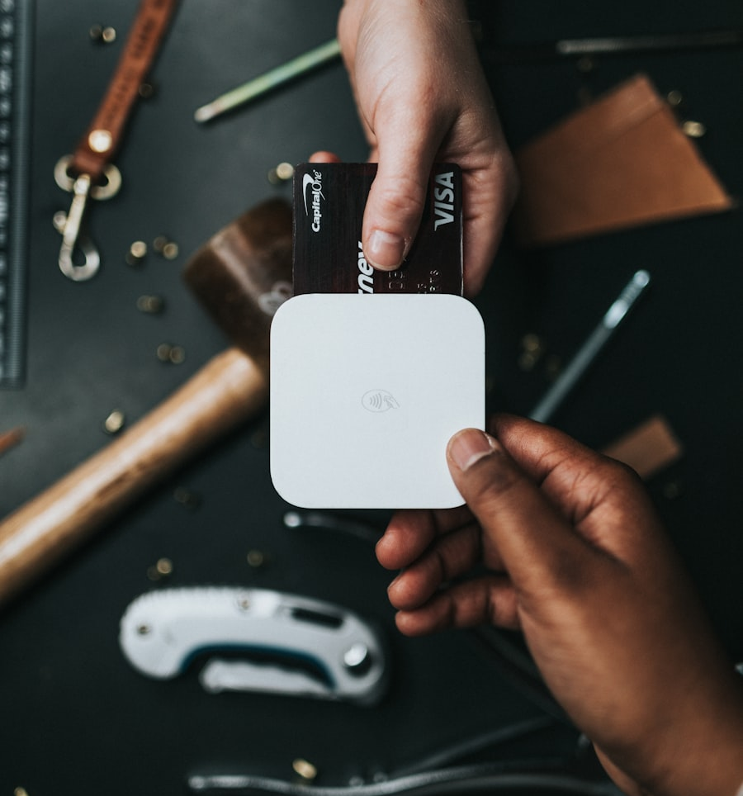
Key Offerings
Smart Display Solutions
7" and 3.5" Dynamic QR Code Displays
Digital Soundbox Systems
DQR-222 Series with Audio Feedback
QR Code Scanners
DQR-111 Series for Payment Processing
Connectivity Options
USB, WiFi, and Bluetooth Integration

Slide 3
Features & Benefits
Real-time Updates
Flexible Display
Durable Design
Dynamic QR code generation and instant content updates.
Portrait and landscape orientations for any setting.
Acrylic, ABS, and PLA enclosure options for longevity.
Easy Integration
Contactless Experience
Scalable Solution
Seamless compatibility with existing payment systems.
Enhanced customer safety and convenience.
Architecture designed for business growth and expansion.

Slide 4
Retail Payments
Digital Signage
POS systems and contactless transactions
Dynamic advertising and information displays
Use Cases
Our versatile solutions adapt to diverse industry needs, from retail to hospitality, enabling seamless digital transformation across multiple sectors.
Inventory Management
Hospitality
Smart tracking and stock management
Restaurant ordering and service systems
Event Management
Service Delivery
Ticketing and access control solutions
Contactless service platforms

Slide 5
Latest Updates
Enhanced DQR-222 Series
Advanced Integration
Improved connectivity options and performance optimization.
Superior USB/WiFi integration for seamless operation.
Next-Gen Scanning
UI Enhancement
Advanced QR code scanning technology with improved accuracy.
Streamlined user interface designs for better experience.
Material Options
AI-Powered Services
Expanded enclosure materials including sustainable options.
Advanced firmware development with machine learning.

Slide 6
Why Choose Bonrix
Industry Leadership
Comprehensive Portfolio
Cutting-Edge Technology
Leading provider of innovative embedded electronics solutions.
Complete product range for diverse business needs.
AI/ML integration for next-generation solutions.
Your Partner for Future-Ready Embedded Systems

Slide 7
Company Profile
Mission
Contact Information
To empower businesses with innovative embedded technology solutions that drive growth and operational efficiency.
A-701 Dev Aurum Commercial
Ahmedabad, Gujarat, India
Vision
+91-9409745500, +91-9429045500
To lead the digital transformation through pioneering IoT and embedded systems innovation.
info@embedded-innovations.com
www.embedded-innovations.com
Core Services
• Embedded Design
• AI/ML Development
• PCB Design
• Enclosure Engineering

